Slide 1
Dynamic Resource Routing using Real-Time Dynamic Programming
曾进

Slide 2
Abstract
1 Introduction
2 Related Work
3 Dynamic Resource Routing
4 MDP Model for DRRP
5 Bound Heuristic Improvements
6 Approximations
7 Evaluation
8 Conclusion

Slide 3
Abstract
Dynamic Resource Routing Problem
MDP
RTDP
Bound Heuristic Improvements

Slide 4
1 Introduction

Slide 5
2 Related Work

Slide 6
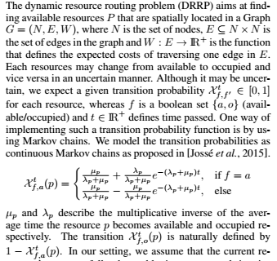
3 Dynamic Resource Routing

Slide 7



4 MDP Model for DRRP

Slide 8
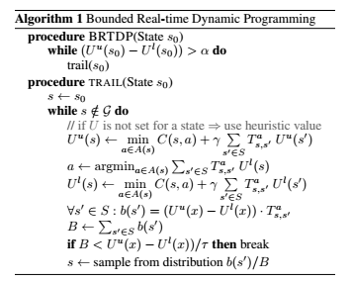

Slide 9
5 Bound Heuristic Improvements
Lower bound heuristic
Upper bound heuristic
-Dijkstra Sweep for Monotone Pessimistic Initialization(DS-MPI)
  Minimun Expected Wait Time(MEWT)

Slide 10
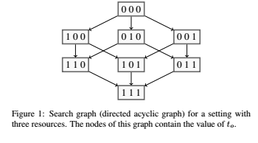

Slide 11
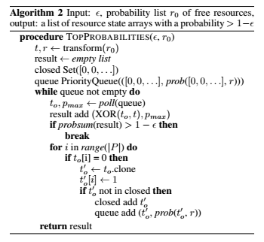
6 Approximations

Slide 12




Slide 13
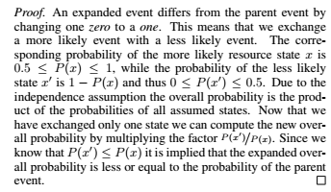

Slide 14
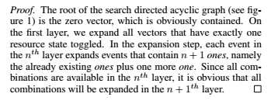

Slide 15
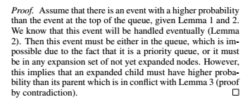

Slide 16
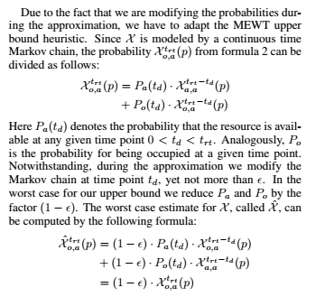

Slide 17


Slide 18

7 Evaluation

Slide 19
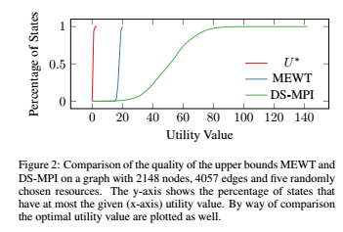

Slide 20
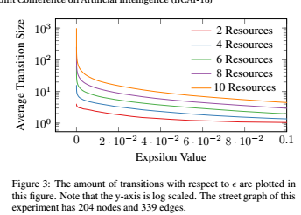

Slide 21
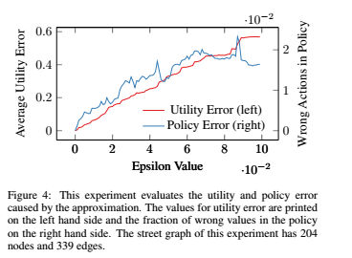


Slide 22
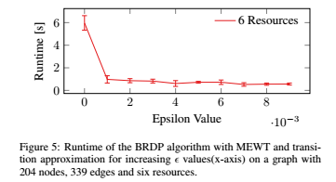

Slide 23
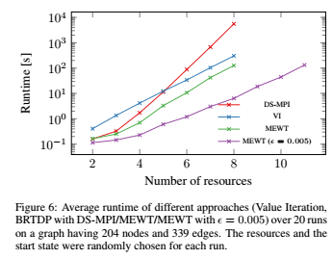

Slide 24
8 Conclusion

Slide 25
Thanks！

